Slide 1
Sequence and Activity Diagrams

Slide 2
Exercise 8: Draw Sequence Diagram
“Compute Price” use case is invoked by customer in the context of a specific order to calculate price of the order.
  All the line items are examined to determine their prices, which are based on the pricing rules of the order line’s products.
  Then the overall discount is computed, which is based on rules tied to the customer.

Slide 3
Solution : First Identify Classes
“Compute Price” use case is invoked by customer in the context of a specific order to calculate price of the order.
  All the line items are examined to determine their prices, which are based on the pricing rules of the order line’s products.
  Then the overall discount is computed, which is based on rules tied to the customer.

Slide 4

Exercise 8: Example Answer
:Customer
:Order
:OrderLine
:Product
calculatePrice
Loop
For all line items
getQuantity
getProduct
getPricingDetails
getDiscountInfo
calculateDiscounts

Slide 5
Collaboration Diagram
Known as Communication Diagram in UML 2
Shows both structural and behavioural aspects:
  Objects are collaborator, shown as boxes
  Messages between objects shown as labelled arrow placed near links
Messages are prefixed with sequence numbers to show relative sequencing
3 : notify()
4 : update()
s1 :StockQuote
Subscriber
1 : attach(s1)
6 : getState()
p : Stock
QuotePublisher
5 : update()
s2 :StockQuote
Subscriber
2 : attach(s2)
7 : getState()

Slide 6
Interaction Diagram: sequence vs communication
objects
p : StockQuotePublisher
s1 : StockQuoteSubscriber
s2 : StockQuoteSubscriber
attach(s1)
attach(s2)
Procedure call, RMI, JDBC, …
Observer
design
pattern
Time
notify()
update()
{update < 1 minutes}
getState()
update()
getState()
3 : notify()
4 : update()
s1 :StockQuoteSubscriber
1 : attach(s1)
6 : getState()
p : StockQuotePublisher
5 : update()
s2 :StockQuoteSubscriber
2 : attach(s2)
7 : getState()

Slide 7
Collaboration Diagram for the renew book use case
:Book
6: * find
9: update
:Library
Boundary
:Library
Book
Renewal
Controller
:Library
Book
Register
:Book
:Library
Member
:Library
Book
Register
[reserved]
renewBook
find MemberBorrowing
displayBorrowing
8: apology
10: confirm
selectBooks
bookSelected
5: book
Selected
* find
[reserved]
[reserved]
[reserved]
apology
update
:Library
Boundary
1: renewBook
:Library
Book
Renewal
Controller
apology
7: apology
3: display
Borrowing
confirm
2: findMemberBorrowing
confirm
4: selectBooks
updateMemberBorrowing
12: confirm
:Library
Member
updateMemberBorrowing

Slide 8
Activity Diagram

Slide 9
Activity Diagram
Not present in earlier modelling languages:
  Possibly based on event diagram of Odell [1992]
Often used to represent processing steps involving a group of use cases (workflow) :
  Activities may not correspond to methods
An activity is a state with an internal action and has one incoming and one outgoing transition.
Vaguely similar to a flowchart
Fill Order

Slide 10
Uses of Activity Diagram
Normally employed in business process modelling.
  Spans one or more use cases
Carried out during requirements analysis and specification stage.
Useful in developing use cases and test cases.

Slide 11
Basic Activity diagram Example
Activity
Join
[order reject]
Receive
Pack
Ship
Close
Order
Order
Order
Order
[order
accepted]
Decision
Merge
Fork
Object
Send
Make
Payment
Accept
Invoice
Invoice
Payment

Slide 12
Activity Diagram Elements
Initial node
Activity final node
Action
Action Flow/Object flow/edge
Fork
Join
Decision
Merge
Synch
Object

Slide 13
Nodes in Activity Diagram
UML 2.0 defines several types of nodes in an activity diagram:
  Activity nodes
  Object nodes
  Control nodes

Slide 14
Activity
The fundamental unit for execution or behavior.
  Represents some transformations or processing in the modeled system
  Few Examples: Receive order, Check order, Ship order, Ship invoice, etc.
Receive order

Slide 15
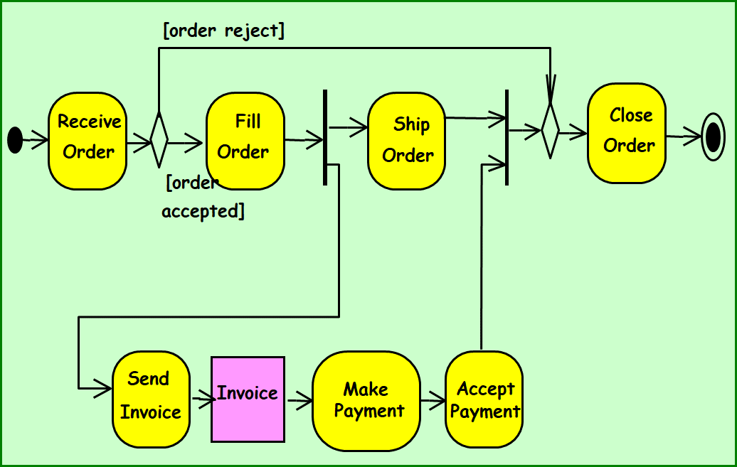
Flows
Flows in an activity diagram do not have labels.
Two types:
  Control-flow transitions indicate completion of an action and possibly start of another
  Object-flow transitions indicate that an action inputs or outputs an object

Slide 16
Control Nodes
Borrowed from state machines
Initial state
Final state
Decision and merge
Fork and join

Slide 17
Initial and Final Nodes
Initial node: filled circle.
Final node: Circle around filled circle
  An activity diagram can have zero or more final nodes
First Action

Slide 18
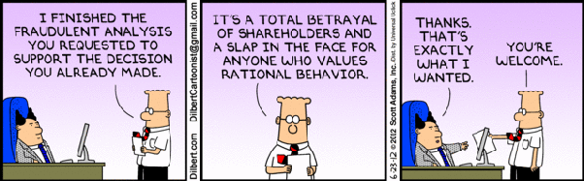

Slide 19
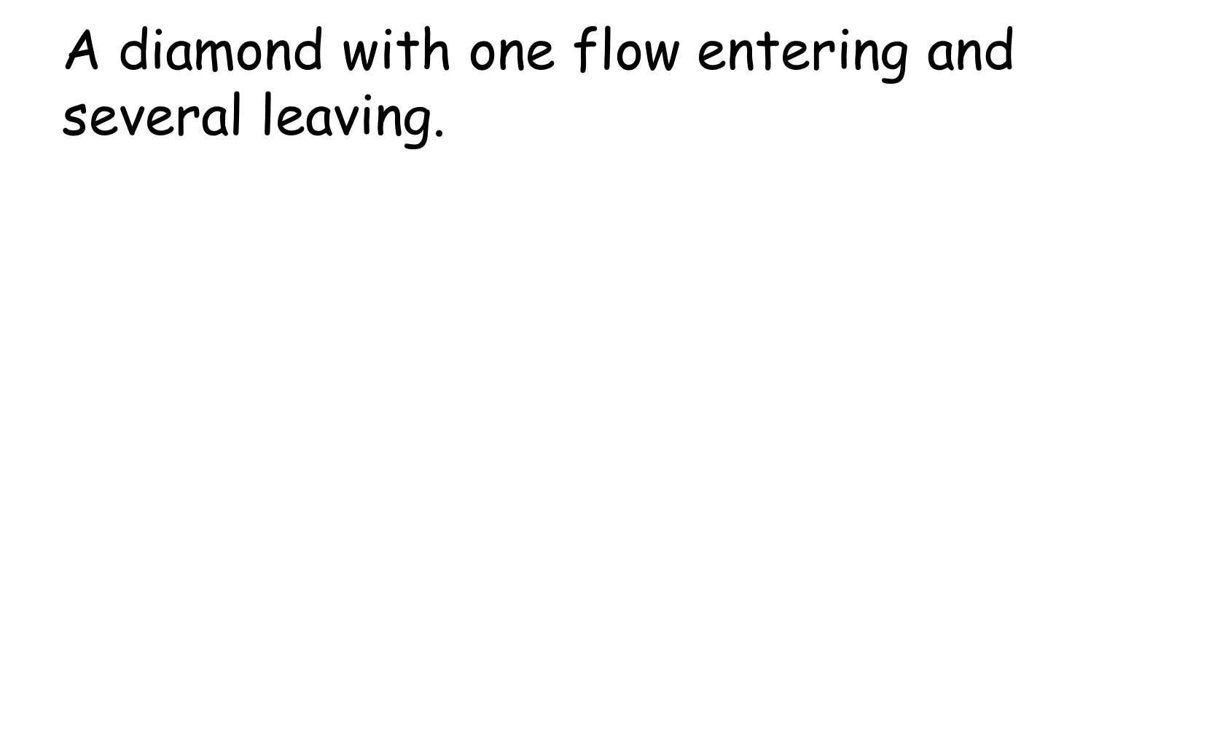
Decision
[Customer Is less than 21 Years Old]
Customer Orders Drink
[Customer Is At least 21 Years Old]
Serve Drink

Slide 20
Decision and merge
Calculate
Cost
[cost < 50]
Charge
Account
[cost >= 50]
Get
Authorization
Notes:
Use merge instead of dummy state before join.

Slide 21
Fork
Denotes the beginning of parallel actions.
Verify Order Products Are In Stock
Receive Order
Verify Customer Has Available Credit

Slide 22
Join
Models Synchronization: several flows entering and only one leaving.
All incoming flows must reach it before processing can continue.
  This denotes the end of parallel processing.
Verify Order Products Are In Stock
Accept Order
Verify Customer Has Available Credit
Synchronization bar

Slide 23

Summary of Activity Diagram Nodes
Three type of nodes:
  Action nodes: executable activity
  Control nodes: coordinate flows in an activity diagram between nodes
  Object nodes: indicate an instance of a particular object, may be available at a particular point in the activity
Receive order

Slide 24
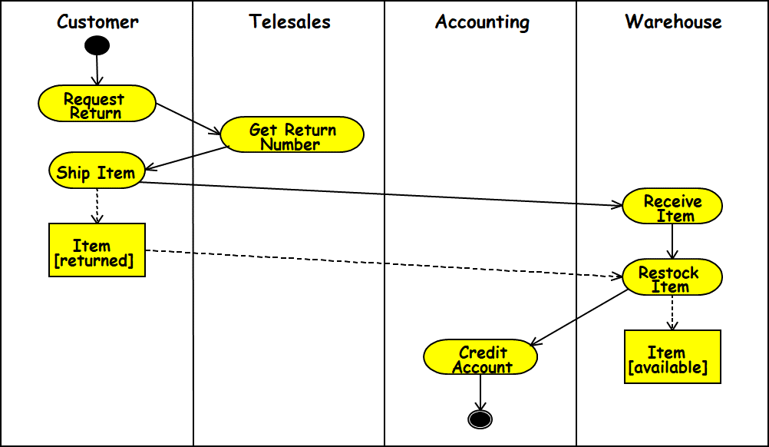
Swim Lane
Swim lanes are used to represent who performs which activities.
Each action is assigned to one swim lane.
Activity flows can cross lanes.
Relative ordering of swim lanes has no semantic significance.

Slide 25
Customer
Sales
Stockroom
Request service
Take Order
Pay
Pack Order
Dispatch Items
Collect items
C-S 546

Slide 26
Object Flow
Take Order
Order
[Taken]
Pack Order
Take Order produces an order object.
Pack Order takes an order object as input.
Dashed lines used with object flow have the same semantics as normal transition.
Notes:
More about semantics of dashed line in pitfalls section.
A step parameter refers to the parameters of the operations invoked by action states. Take Order and Fill Order can be subactivity states, whereupon the parameters are in the first/last action state in the subactivity graph, recursively.

Slide 27
The transition between an object parameter and an action state is represented with a dashed line, instead of a solid line
Customer
Sales
Stockroom
Request service
: Order [placed]
:Order [entered]
Take Order
Pay
Pack Order
: Order [filled]
:Order [delivered]
Collect order
Deliver order

Slide 28
Signals
Signals are essentially messages with external systems/processes.
  Usually appear in pairs of sent and received signals, because often response is expected for sent signals.
Request Payment
Receive Payment
Send signal
Accept signal

Slide 29
Received Signals
A received signal:
  Indicates that the activity receives an event from an outside process.
  An activity listens to signals, and the diagram defines how the activity reacts.
A ‘time signal’ occurs on passage of time
  For example, each month end might trigger a signal.

Slide 30
Signals
Basically, signals are flow triggers.
Send signal Time signal Accept signal

Slide 31
Process Order
Request Payment
Receive
Payment
Ship Order
Report
Meter Reading
Receive
Cancel Request
Cancel Order
At end of month

Slide 32
Activity Diagram vs Flow Chart
Can represent parallel activity and synchronization aspects
Swim lanes:
  Allows grouping activities based on who is performing them
Example: Academic department vs. Hostel

Slide 33
Activity Diagram Example: Student Registration
initial
Initialize
activity
Add student
fork/spawn
Notify Teacher
Notify Billing
Synchronization
[else]
[ count < 100 ]
guard
Close course
final

Slide 34
Another Example Activity Diagram: student admission process at IIT
Academic Section
Accounts Section
Hostel Office
Hospital
Department
check
student
records
receive
fees
allot
hostel
create
hospital
record
receive
fees
register
in
course
conduct
medical
examination
allot
room
issue
identity card

Slide 35
Activity Diagram: Example 3
Finance
Order
Processing
Stock
Manager
Receive
Order
Receive
Supply
*[for each line
item on order]
Choose
Outstanding
Order Items
Check
Line Item
Authorize
Payment
[failed]
* [for each chosen
order item]
Cancel
Order
[in stock]
Assign to
Order
Assign
Goods to
Order
[succeeded]
[need to reorder]
Reorder
Item
[stock assigned to all
line items and payment
authorized]
[all outstanding
order items filled]
Dispatch
Order

Slide 36
Activity Diagram Example 4
Customer
Telesales
Accounts
Warehouse
Request
Order
Take
Order
Generate
Invoice
Pay Bill
Invoice
Pack
Order
Verify
Account
Ship
Order
Notes:
Diagram assumes that:
1) Receive Item and the OFS Item can be traversed in parallel. Same for Credit Account and Item OFS.
2) Restock item will not start until its Item input has arrived.
3) State machine can terminate with hanging Item OFS.
These are natural assumptions for an object flow language, but UML is state machine based.

Slide 37
Activity Diagram: Example 5
Customer
Telesales
Accounting
Warehouse
Request
Return
Get Return
Number
Ship Item
Receive
Item
Item
[returned]
Restock
Item
Credit
Item
Account
[available]
Notes:
Diagram assumes that:
1) Receive Item and the OFS Item can be traversed in parallel. Same for Credit Account and Item OFS.
2) Restock item will not start until its Item input has arrived.
3) State machine can terminate with hanging Item OFS.
These are natural assumptions for an object flow language, but UML is state machine based.

Slide 38
Uses and Abuses of Activity Diagrams
Activity diagrams are useful to show behavior that spans multiple use cases:
  Describe the workflow of the overall process.
For multiple objects and their high-level interaction,
  Activity diagrams are particularly helpful for representing an overview of concurrent processes
Activity diagrams are not accurate for describing how an object behaves over its lifetime. Use a state diagram instead.

Slide 39


Slide 40
Quiz 1: Order Processing
The customer service Department receives order and sends out invoice to the customer.
  It also passes on the order to the order processing Department to process the order
If it is a rush order then the customer service Department prepares for an overnight delivery by express mail
  Otherwise it prepares to send by speed post.
As soon as the payment is received by the finance Department from the customer:
  The order is dispatched by the customer service Department and it also closes the order.

Slide 41
Customer services department
Order Processing department
Receive order
Finance department
Fill order
Send invoice
[rush order]
[Else]
Overnight delivery
Ordinary delivery
Receive payment
Quiz 1:
Answer
Close order

Slide 42
Package Diagrams
A package is a grouping of several classes:
  Java packages are a good example
Package diagrams show module dependencies.
Useful for large projects with multiple binary files
Order Capture
UI
AWT
Mailing List
UI
Order Capture
Application
Mailing List
Application
Dependency
Common
{global}
Oracle
Interface
Quantity
Money
DateRange
Domain
Orders
Customers
Sybase
Interface
Database
Interface
{abstract}

Slide 43
Component Diagram
Captures physical structure of the implementation.
Purpose:
  Organize source code
  Construct an executable release
  Specify dependencies

Slide 44
Component Diagram
What is a component?
  A piece of software that can be independently purchased and upgraded, and can integrate seamlessly into customers’ existing software.
Librarian
Librarian
UML 1 notation
UML 2 notation

Slide 45
Ball and Socket notation for Interfaces
Ball and socket notation is new in UML 2.0.
Components that consume (require) an interface:
  Display a "socket" labeled with the interface name .
Components that provide (implement) an interface:
  Display a "ball" labeled with the interface name.
Combining the two:
  A compact way to say that Consumer talks to the provider via the named interface.

Slide 46
Component Diagram: Example
Library
UI
Librarian
DB
Ports can be named, such as the Security and Data ports
Database

Slide 47
Deployment Diagram
The deployment diagram shows:
  How a software system will be physically deployed in the hardware environment.
Its main purpose is:
  Show where the different components of the system will physically run and
  How they will communicate with each other.
Since the diagram models the physical runtime:
  A system's operation staff make considerable use of this diagram.

Slide 48
Deployment Diagram
Node:
  Something that can host a program artifact.
  A node represents a physical machine.
  To model a node, draw a three-dimensional cube with the name of the node at the top.
  Physical nodes should be labeled with the stereotype device
Program Artifact:
  Files, assemblies, DLL, or scripts
  An artifact is usually a component

Slide 49
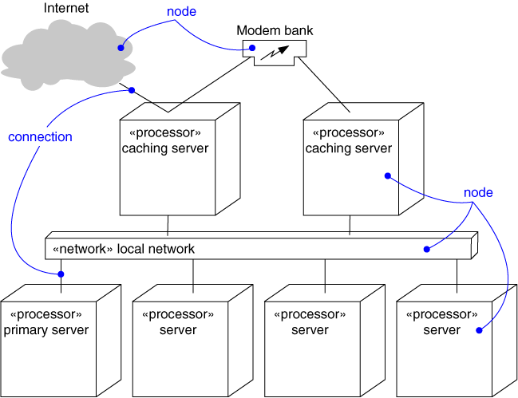
Deployment Diagram
Captures the topology of a system’s hardware
(A piece of hardware)

Slide 50
Architectural Modeling Using
Deployment Diagram
Terminal
2
Terminal
Terminal
X
1
Branch
Server
ATM X
Terminal
1
Branch
Hub
Central
Terminal
Server
Bank
2
ATM 1
ATM 2
Terminal
X

Slide 51
OOAD

Slide 52
A Design Process
We discuss a design process based to a large extent on Larman’s approach:
  Also synthesizes features from various other methodologies.
From requirements specification, an initial model is developed (OOA):‏
  Analysis model is iteratively refined into a design model
Design model is implemented using an OO language.

Slide 53
OOAD
Iterative and Incremental
OOA OOD/OOP
Definition
of
the problem
Domain Model
Use case model
Construction
of
the solution
Specification
Program

Slide 54
OOA versus OOD?
Analysis:
  An elaboration of requirements.
  Independent of any specific implementation
Design:
  A refinement of the analysis model.
  Takes implementation constraints into account

Slide 55
A Generic Design Process
OOA
OOD
User interface
Issues or GUI
prototype
Use case
diagram
Interaction
diagram
Start
SRS
document
Domain
model
Class
diagram
Code
Glossary

Slide 56
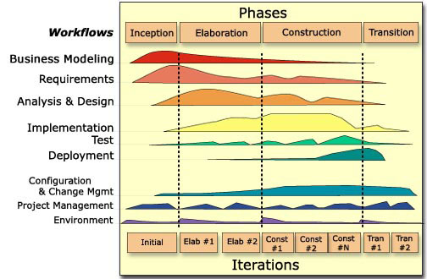
Two dimensions of RUP

Slide 57
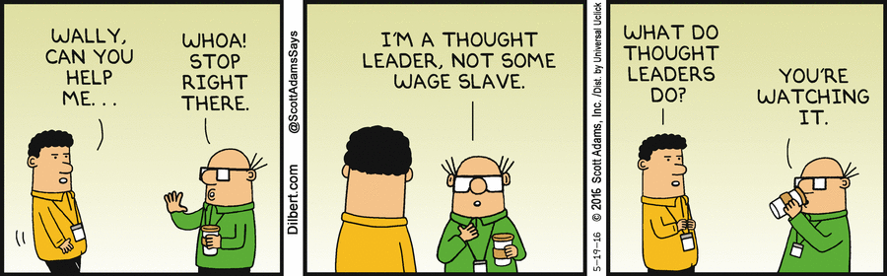

Slide 58
Crux of an OO Design Process…
Conceptual Class Diagram
Domain Model
Define terms
Class
Diagram
Use Case
Model
Domain
objects
Glossary
Functional Requirements
Interaction Diagrams
Dynamic Behavior

Slide 59
Domain Modelling
Represent concepts or objects appearing in the problem domain.
  Also capture object relationships.
Three types of objects are identified:
  Boundary objects
  Entity objects
  Controller objects

Slide 60
Class Stereotypes
Three different stereotypes are used to represent classes :
<<boundary>>, <<control>>, <<entity>>.
Boundary
Cashier Interface
Control
Withdrawal
manager
Entity
Account

Slide 61
Domain model vs.
Design Class Diagram – What difference?
Domain Model
Conceptual
Perspective
1 captures *
Sale
Register
Design Model
Software
Implementation perspective
Register
…
endSale()
enterItem(...)
makePayment(...)
Sale
time
isComplete:Boolean
total
makeLineItem(...)
*
captures

Slide 62
Boundary Objects
Handle interaction with actors:
  User interface objects
Often implemented as screens, menus, forms, dialogs etc.
Do not perform processing:
  But may validate input, format output, etc.

Slide 63
Entity Objects
Hold information over long term:
  e.g. Book, BookRegister
Normally are dumb servers:
  Responsible for storing data, fetching data etc.
  Elementary operations on data such as searching, sorting, etc.
Often appear as nouns in the problem description...

Slide 64
Controller Objects
Help to realize use case behavior:
  Interface with the boundary objects
  Coordinate the activities of a set of entity objects
Embody most of the business logic:
  Involved with use case execution.
There can be more than one controller to realize a single use case

Slide 65
Controller Classes
Controller classes coordinate, sequence, transact, and otherwise control other objects…
In Smalltalk MVC mechanism:
  These are called controllers

Slide 66
Example Use Case Realization
Boundary 1
Controller
Boundary 2
Entity 1
Entity 2
Entity 3
Realization of use case through the collaboration of
Boundary, controller and entity objects

